Slide 1

ISP392: FINAL PROJECT PRESENTATION
ISP392_Group2

Slide 2
Project Overview
Product Introduction & Scope
    Our project, YEN Coffee House Management System, is a web-based platform designed to help coffee shop owners manage daily operations effectively.
It provides integrated modules for:
    Sales & Orders: Handle in-store and online customer orders, with payment options (PayOS or Cash).
    Marketing: Manage products, promotions, and campaigns.
    HR: Manage user accounts and staff roles.
    Admin Dashboard: Oversee all departments, including users, products, promotions, and system settings.
    The system aims to digitalize the sales process, enhance customer experience, and support business decision-making through dashboards and reports.

Slide 3
Project Overview
Project Team Members:
1.Nguyen Cong Minh - HE180504
2. Nguyen Vu Duc -HE182533

Slide 4
Project Overview
How Does the Team Manage the Project?
Project Communication:
Weekly meetings on Microsoft Teams and Messenger for discussing progress, assigning tasks, and reviewing deliverables.
Task Assignment & Tracking:
Tasks are managed using GitLab Issues & Boards, where each member is assigned to specific modules with clear deadlines and checklists.
Project Issue Tracking:
Requirements, bugs, and Q&A discussions are documented in GitLab and Google Sheets.
Version control is handled with GitLab Repository, using feature branches and merge requests.

Slide 5
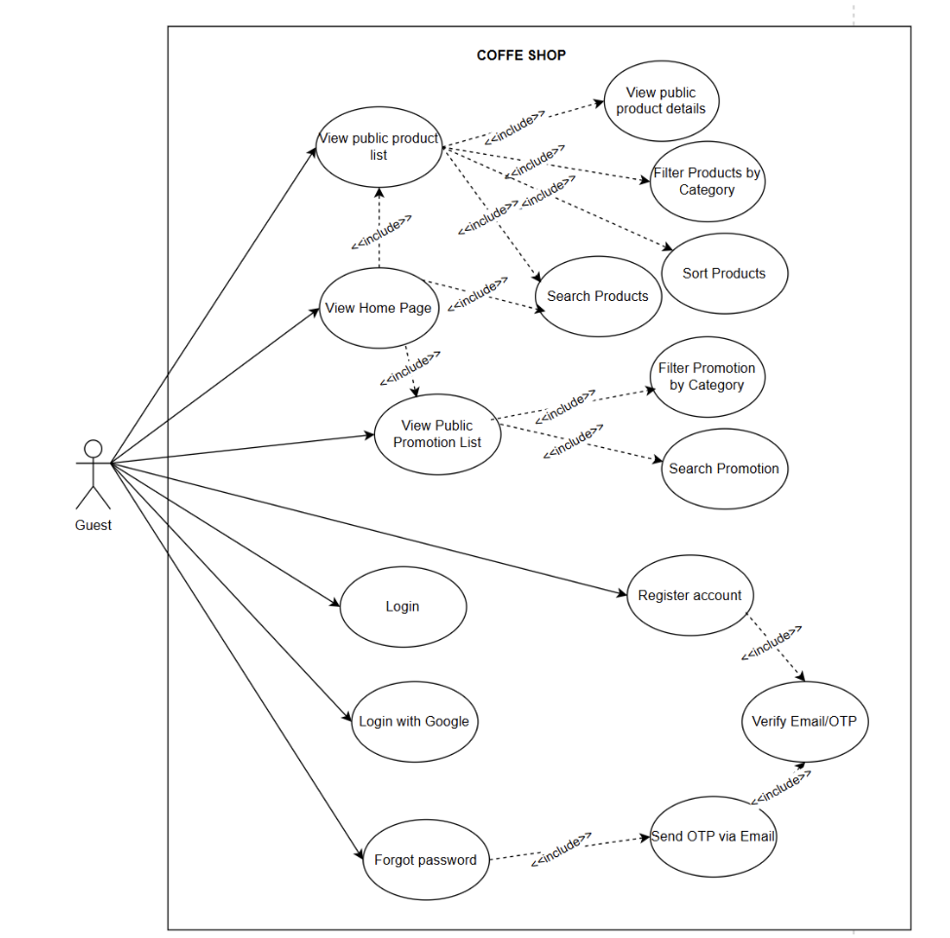
Product Requirements
Use Case Diagrams
UC for Guess

Slide 6
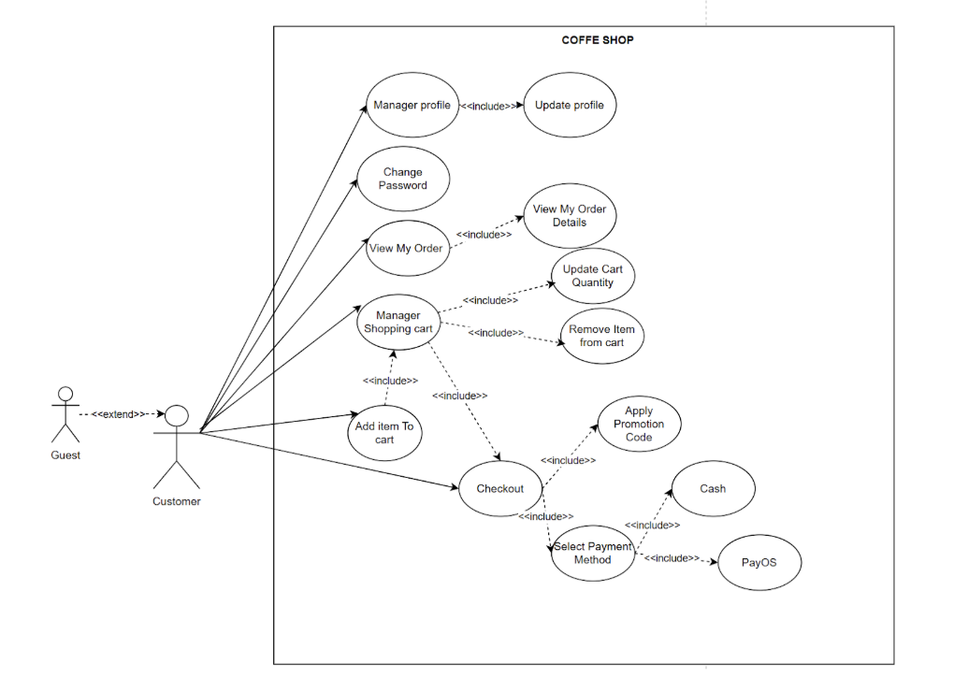
Product Requirements
Use Case Diagrams
UC for Customer

Slide 7
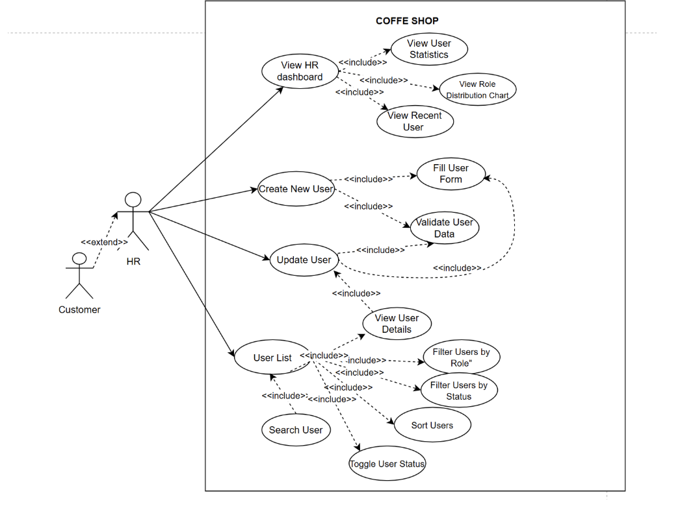
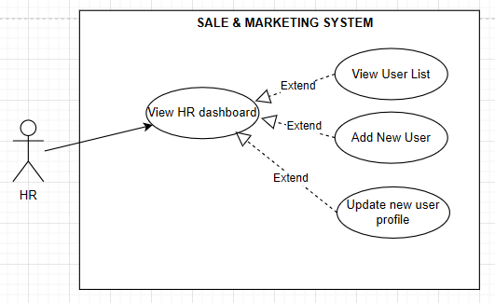
Product Requirements
Use Case Diagrams
UC for HR

Slide 8
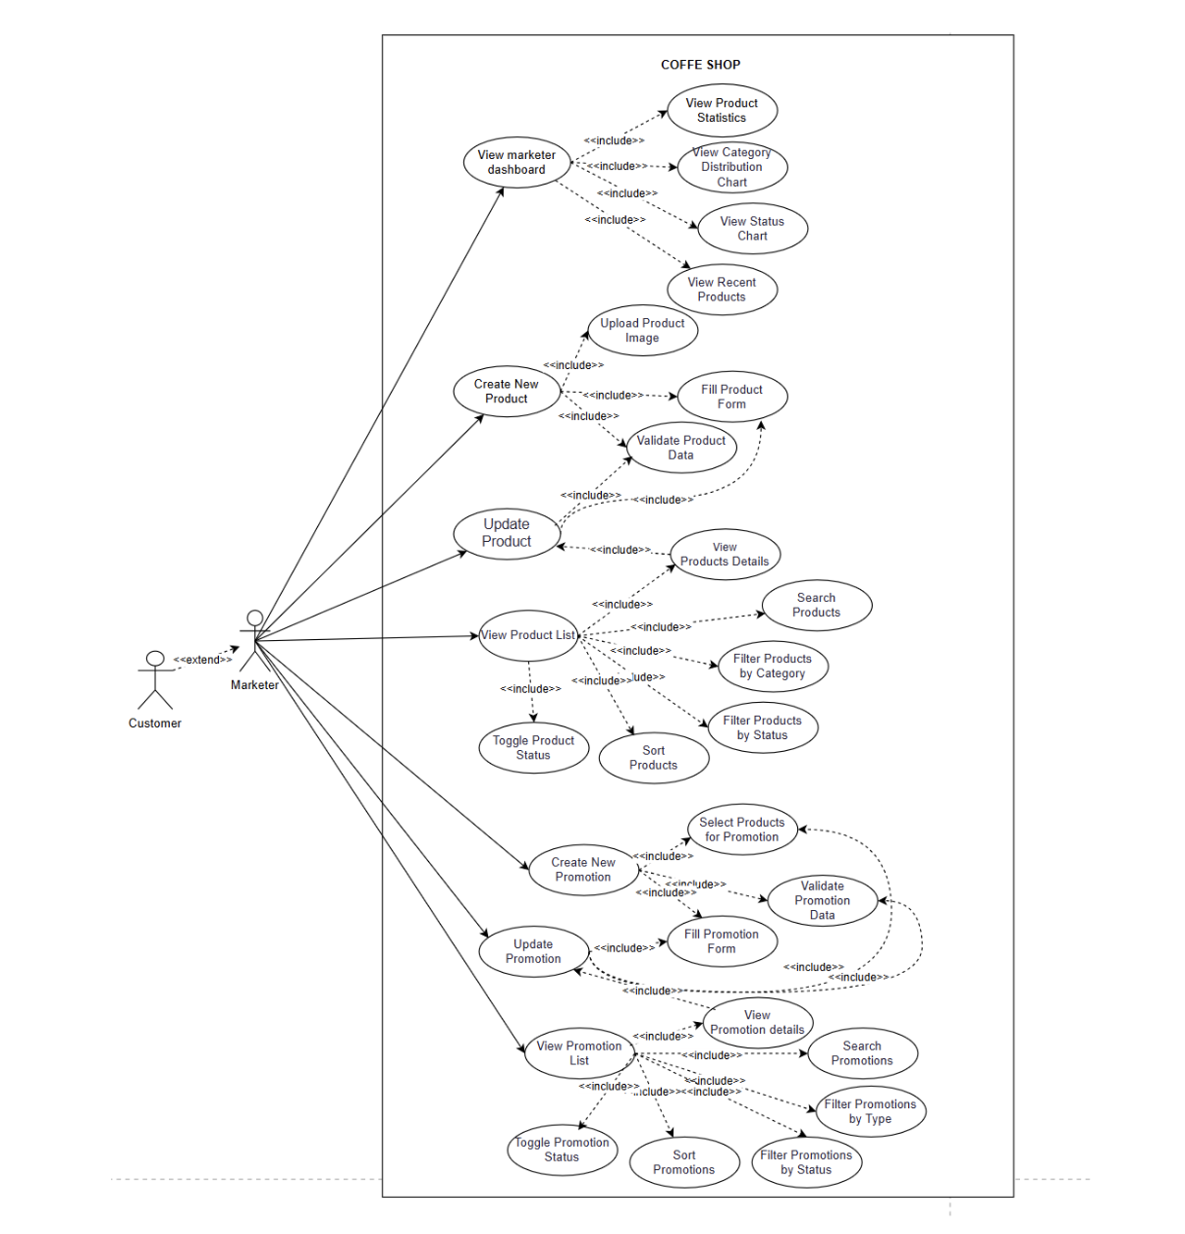
Product Requirements
Use Case Diagrams
UC for Marketer

Slide 9
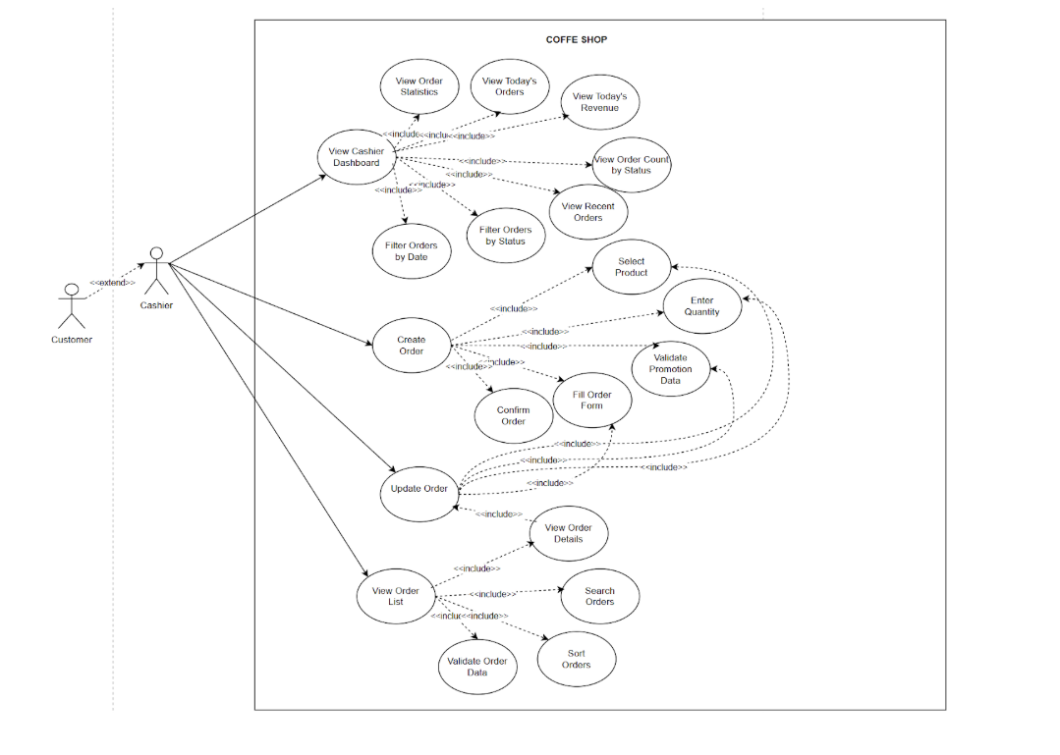
Product Requirements
Use Case Diagrams
UC for Cashier

Slide 10
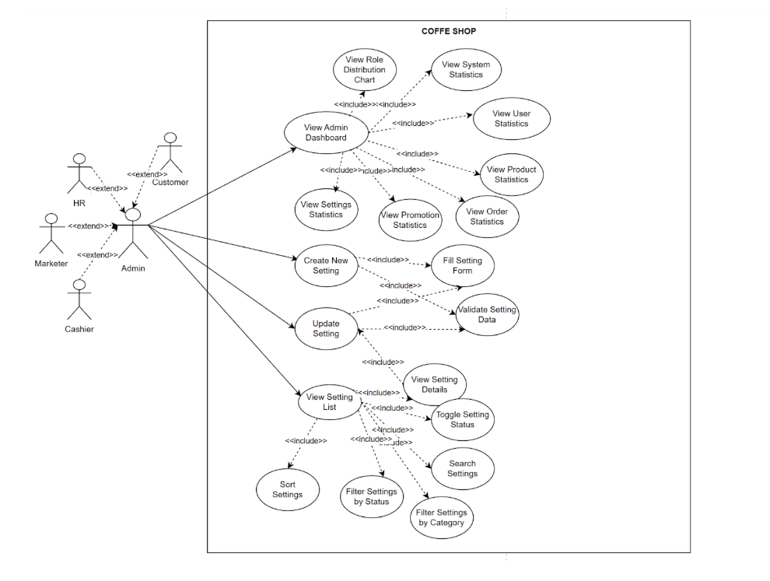
Product Requirements
Use Case Diagrams
UC for Admin

Slide 11
Product Requirements
Product Functionalities
Provide product functionalities that you have completed in the project in the forms of
  Screen flow for all the screens (see sample below)
  List of NonUI functions (if any)

Slide 12
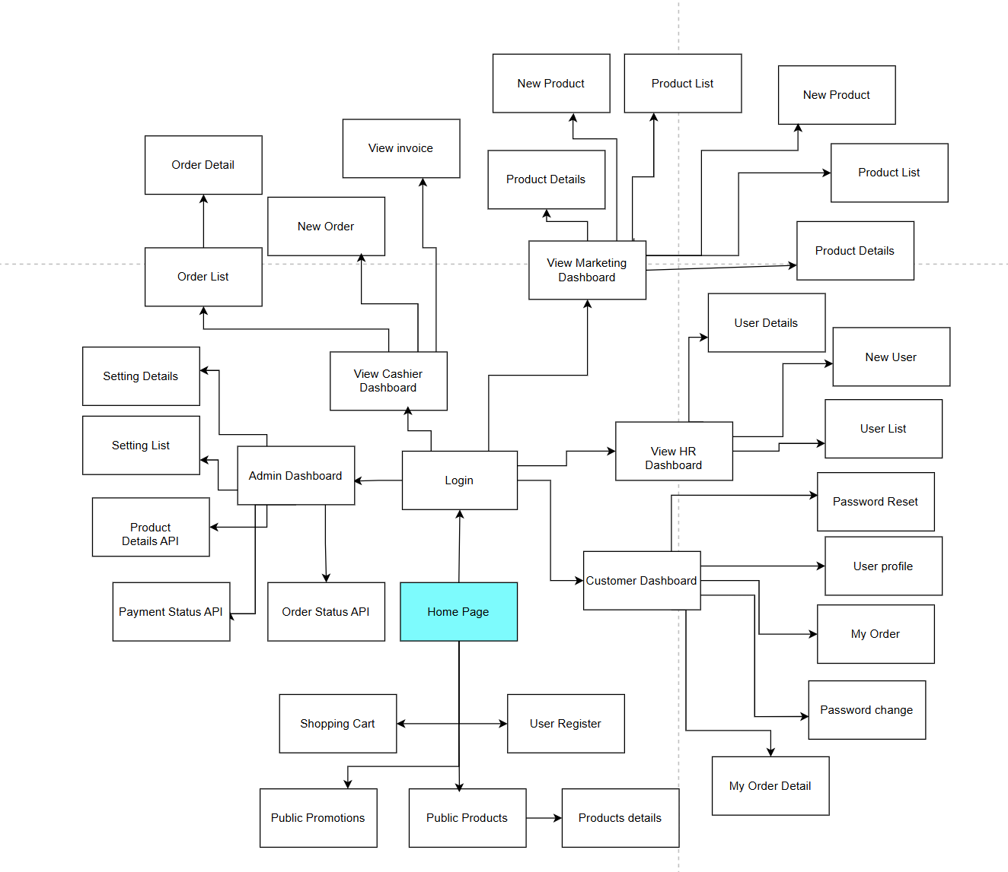
Product Requirements
Product Functionalities
Provide product functionalities that you have completed in the project in the forms of
  Screen flow for all the screens (see sample below)

Slide 13
Product Requirements
Main Screen UI Design
Provide screenshot(s) for the main screens that you have completed
  Main Web screen: Home Page or Landing Page
  Main Admin screen: Dashboard (if any)

Slide 14
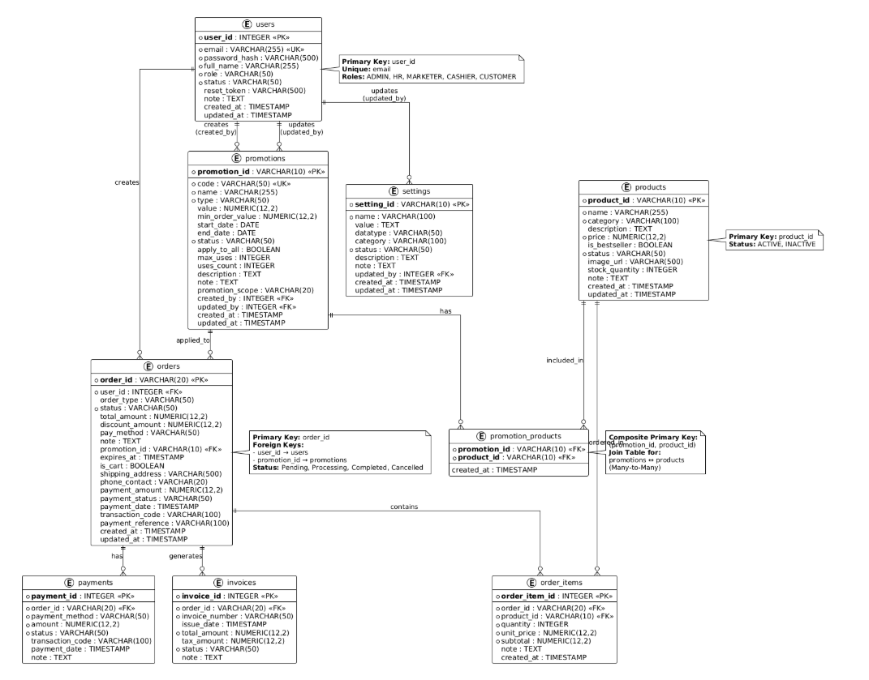
System Design
Database Design
Provide database schema here..

Slide 15
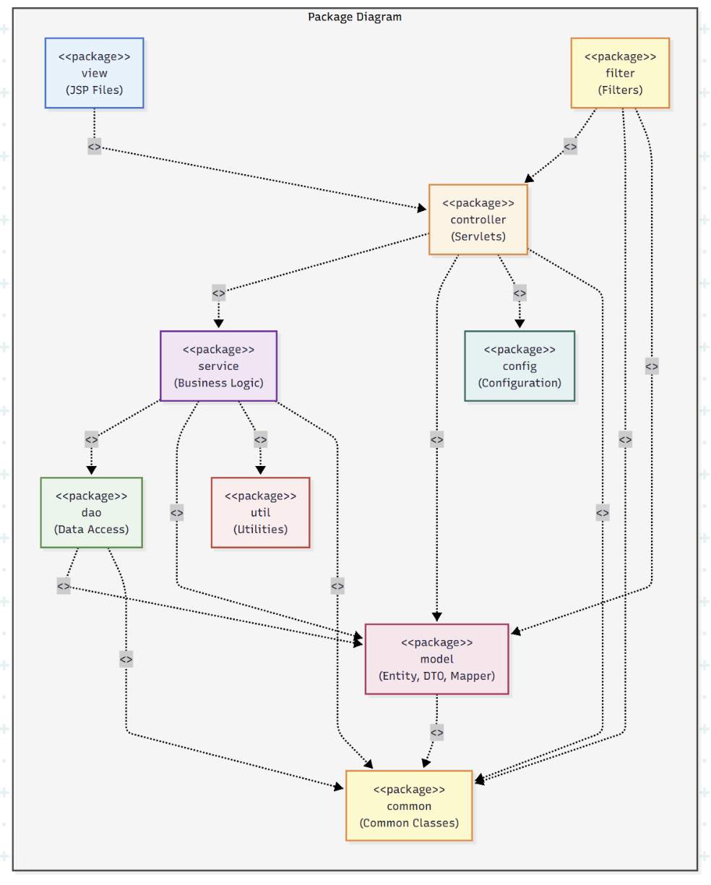
System Design
Package Diagram
Provide system
package diagram
here..

Slide 16
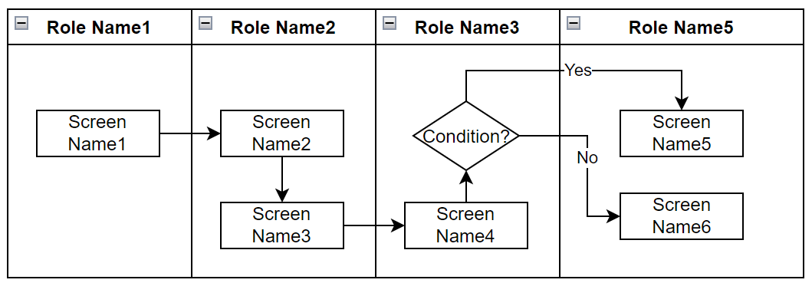
Demonstration
Provide the main workflow(s) that you have completed here..
The workflows can be defined by
  Main managing information/data entities
  Product/system roles or actors
Each workflow is designed in the form of a swimlane diagram in which screens & actors/roles are included

Slide 17
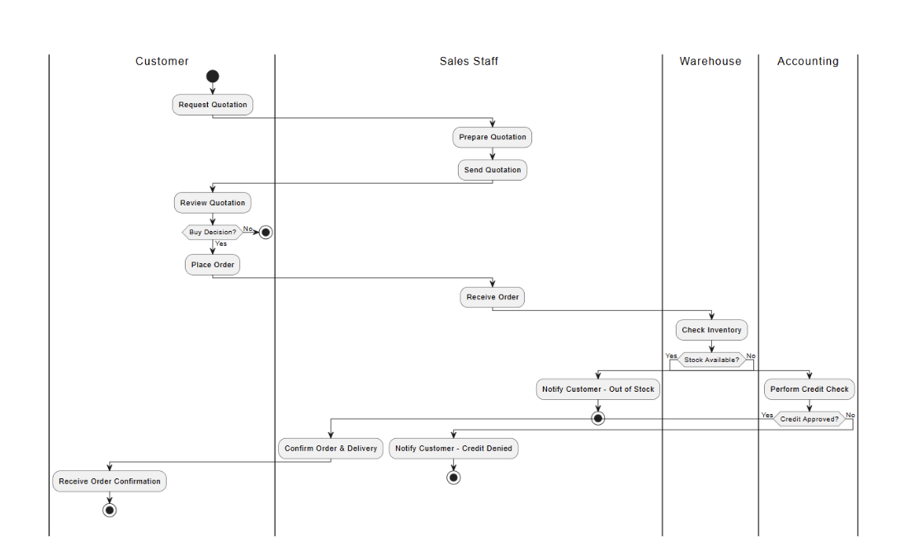
Demonstration
Sale & Marketing Processes

Slide 18
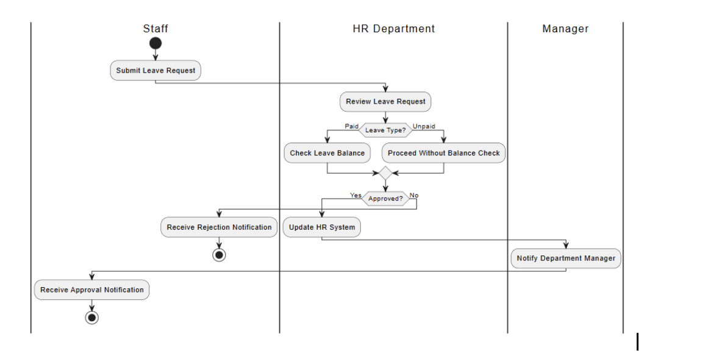
Demonstration
HR Processes

Slide 19
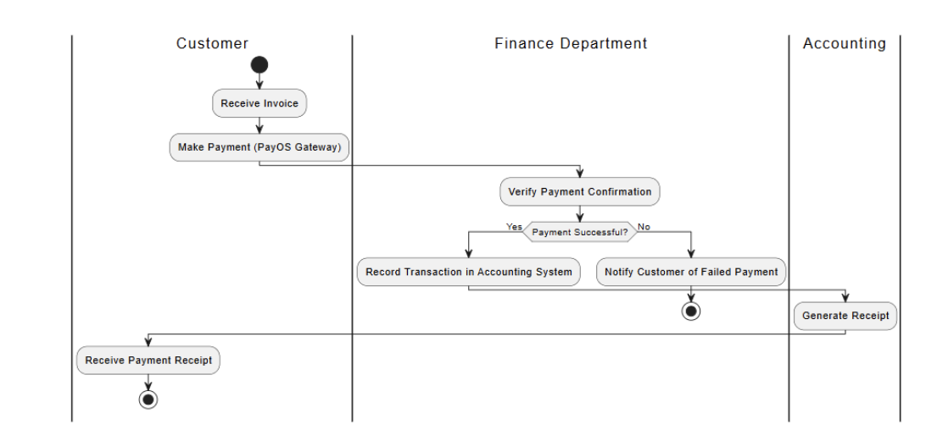
Demonstration
Finance Processes

Slide 20


